Slide 1
AI vs. Human: Academic Essay Authenticity Challenge
PIP104 University Project-II
final Review
Batch Number: 99
Roll Number | Student Name
20211CSE0380 20211CSE0387 20211CSE0371 20211CSE0405 20211CSE0403 | Lavanya J Drushti T R Swarna B B Chaya G Sonali Siddaling bangi
Under the Supervision of,
Mr. Jinesh V N
Assistant Professor
School of Computer Science & Engineering
Presidency University

Slide 2
Introduction
Recent advancements in artificial intelligence (AI), particularly deep learning, have transformed the generation of text, These advancements have opened up new possibilities for various applications, including automated content creation, chatbots, and virtual assistants. However, alongside these benefits, there are growing concerns about the potential misuse of LLMs, particularly in the dissemination of misinformation, the creation of fake news, and instances of plagiarism in academic contexts.
Detecting AI generated text accurately is becoming crucial. making it increasingly challenging to distinguish between human-written and AI-generated content.The urgent need for strong algorithms to distinguish between human-written and AI-generated content. This distinction is vital for protecting the integrity of information and preventing the risks posed by AI misuse, such as misinformation and plagiarism.
By systematically processing text data and employing advanced classification techniques, we aspire to enhance the accuracy and reliability of detection methods.

Slide 3
Literature Review
Ghosal, S. S., Chakraborty, S., Geiping, J., Huang, F., Manocha, D., & Bedi, A. S., “Towards possibilities & impossibilities of AI-generated text detection: A survey,” arXiv preprint, pp. 1-35, Oct. 2023, doi: 10.48550/arXiv.2310.15264.
Sadasivan, V. S., Kumar, A., Balasubramanian, S., Wang, W., & Feizi, S., “Can AI-generated text be reliably detected?,” *arXiv preprint*, pp. 1-27, Mar. 2023, doi: 10.48550/arXiv.2303.11156.
Wu, J., Yang, S., Zhan, R., Yuan, Y., Wong, D. F., & Chao, L. S., “A survey on LLM-generated text detection: Necessity, methods, and future directions,” *arXiv preprint*, pp. 1-29, Oct. 2023, doi: 10.48550/arXiv.2310.14724.
Wang, H., Li, J., & Li, Z., “AI-generated text detection and classification based on BERT deep learning algorithm,” *arXiv preprint*, pp. 1-18, May 2024, doi: 10.48550/arXiv.2405.16422.
Bakhtin, A., Gross, S., Ott, M., Deng, Y., Ranzato, M. A., & Szlam, A., “Real or fake? Learning to discriminate machine from human-generated text,” *arXiv preprint*, pp. 1-8, Jun. 2019, doi: 10.48550/arXiv.1906.03351.
Dou, Y., Forbes, M., Koncel-Kedziorski, R., Smith, N. A., & Choi, Y., “Is GPT-3 text indistinguishable from human text? Scarecrow: A framework for scrutinizing machine text,” *arXiv preprint*, pp. 1-12, Jul. 2021, doi: 10.48550/arXiv.2107.01294.
Li, Y., Li, Q., Cui, L., Bi, W., Wang, Z., Wang, L., Yang, L., Shi, S., & Zhang, Y., “MAGE: Machine-generated text detection in the wild,” *In Proceedings of the 62nd Annual Meeting of the Association for Computational Linguistics (Volume 1: Long Papers)*, pp. 36-53, 2024, doi: 10.18653/v1/2024.acl-long.4.
Bahad, S., Bhaskar, Y., & Krishnamurthy, P., “Fine-tuning language models for AI vs. human-generated text detection,” *In Proceedings of the 18th International Workshop on Semantic Evaluation (SemEval-2024)*, pp. 918-921, 2024, doi: 10.18653/v1/2024.semeval-1.112.
Petropoulos, Panagiotis, and Vasilis Petropoulos. "RoBERTa and Bi-LSTM for human vs AI generated text detection." Working Notes of CLEF (2024).

Slide 4
Existing method Drawback
Keyword Matching & Rule-based Systems
Limited Scope:
Works only for simple, predictable patterns in text.
Ineffective against advanced AI-generated content that mimics human writing styles.
High False Negatives:
AI models like GPT-3 and GPT-4 can bypass detection by varying sentence structures and using synonyms.
Statistical Methods (e.g., Perplexity, N-grams)
Struggles with Sophisticated AI Models:
Advanced models produce content with low perplexity, similar to human writing, reducing detection accuracy.
Inconsistent Performance Across Text Types:
Works better with long texts but struggles with short-form content (e.g., tweets, messages).
Context Limitation:
Fails to capture deeper meaning and context within the text.

Slide 5
Proposed Method
Academic institutions are increasingly concerned about students using AI tools (e.g., ChatGPT, GPT-4) to generate essays and assignments. This proposal suggests a BERT-based model fine-tuned specifically for academic essay detection. The model will analyze contextual and linguistic patterns characteristic of human-written vs. AI-generated essays.
Data Collection
Preprocessing the Text Data
BERT Fine-Tuning Approach
Handling Imbalanced Data
Evaluation and Validation
Deployment and Inference

Slide 6
Objectives
Detection and Prevention
Assistance without Overreliance
Transparency and Accountability
Preservation of Academic Integrity
Developing Critical Thinking:
Balancing AI Usage and Originality

Slide 7
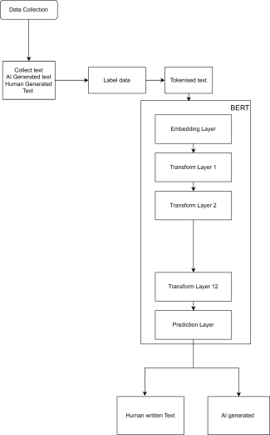
Architecture

Slide 8
Hardware/software components
Hardware Components
GPU: NVIDIA RTX 3090 with 32GB VRAM
CPU:Multi-core processor (e.g., Intel Core i9 or AMD Ryzen 9).
RAM:At least 64GB DDR4/DDR5 RAM for managing large datasets and intermediate computations.
Storage:SSD (2TB or more) for fast data access and model checkpoints.
Power Supply Unit:A high-capacity PSU (750W+) to support the GPU’s power requirements.
Software Components
Programming Language:Python 3.10
Deep Learning Libraries:PyTorch or TensorFlow
Transformers Library (Hugging Face)
Development Environment:Jupyter Notebooks or VS Code
OS and Drivers:Ubuntu 20.04 LTS (or newer) for optimal GPU support.
Dataset Management:Pandas and Numpy
Version Control:Git and GitHub/GitLab
Evaluation Tools:Scikit-learn

Slide 9
Timeline of the Project (Gantt Chart)
09
10
11
12
W1
W2
W3
W4
W1
W2
W3
W4
W1
W2
W3
W4
W1
W2
W3
W4
Project Planning and Proposal
Topic selection, literature review, problem statement, methodology, timeline, proposal submission
Data Collection and Analysis
Results and Discussion
Data collection, cleaning, preprocessing, analysis
Interpretation of results, discussion, limitations
Report Writing and Presentation
Report writing, presentation preparation, rehearsals
Project Defense and Submission
Final revisions, project defense, submission

Slide 10
Expected Outcomes
High Detection Accuracy
The model will accurately classify essays as AI-generated or human-written, achieving a high overall accuracy rate
Works effectively across different academic disciplines and topics.
Generalization capability
To detect content generated by different AI models.
Low False Positive Rate
The system will minimize wrongful classification of genuine student work as AI-generated, ensuring fairness and preventing false accusations of misconduct.
Scalable Real-Time Performance
The model will be lightweight enough to process essays quickly, suitable for integration into real-time platforms such as learning management systems (LMS) or plagiarism checkers (like Turnitin).

Slide 11
Conclusion
As AI-generated text becomes more prevalent, especially in academic contexts, there is an urgent need for robust and reliable detection systems to maintain academic integrity. This proposal introduces a BERT-based model fine-tuned for academic essay detection that leverages the power of contextual language understanding and adversarial training to differentiate between AI-generated and human-written content.
The proposed system offers several advantages, including high detection accuracy, scalability, and adaptability to evolving AI models. It addresses critical challenges such as minimizing false positives to prevent unfair penalties and handling diverse writing styles and essay lengths. Additionally, the model is designed to integrate seamlessly into real-time platforms, making it practical for deployment in academic institutions.
By continuously improving through retraining with new datasets and employing adversarial techniques, this system will remain relevant and effective as AI models evolve. Ultimately, the model will play a key role in preserving academic honesty and ensuring responsible use of AI technologies in education.

Slide 12
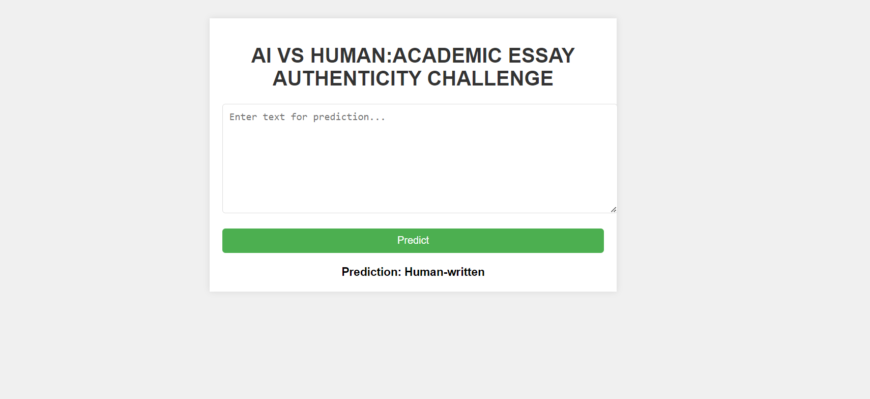
Output

Slide 13
Github Link
https://github.com/Lavanya-jayaprakash

Slide 14
References
Ghosal, S. S., Chakraborty, S., Geiping, J., Huang, F., Manocha, D., & Bedi, A. S. (2023). Towards possibilities & impossibilities of ai-generated text detection: A survey. arXiv preprint arXiv:2310.15264.
Sadasivan, Vinu Sankar, Aounon Kumar, Sriram Balasubramanian, Wenxiao Wang, and Soheil Feizi. "Can AI-generated text be reliably detected?." arXiv preprint arXiv:2303.11156 (2023).
Wu, Junchao, Shu Yang, Runzhe Zhan, Yulin Yuan, Derek F. Wong, and Lidia S. Chao. "A survey on llm-gernerated text detection: Necessity, methods, and future directions." arXiv preprint arXiv:2310.14724 (2023).
Wang, Hao, Jianwei Li, and Zhengyu Li. "AI-Generated Text Detection and Classification Based on BERT Deep Learning Algorithm." arXiv preprint arXiv:2405.16422 (2024).
Bakhtin, Anton, Sam Gross, Myle Ott, Yuntian Deng, Marc'Aurelio Ranzato, and Arthur Szlam. "Real or fake? learning to discriminate machine from human generated text." arXiv preprint arXiv:1906.03351 (2019).
Dou, Yao, Maxwell Forbes, Rik Koncel-Kedziorski, Noah A. Smith, and Yejin Choi. "Is GPT-3 text indistinguishable from human text? scarecrow: A framework for scrutinizing machine text." arXiv preprint arXiv:2107.01294 (2021).
Li, Yafu, Qintong Li, Leyang Cui, Wei Bi, Zhilin Wang, Longyue Wang, Linyi Yang, Shuming Shi, and Yue Zhang. "Mage: Machine-generated text detection in the wild." In Proceedings of the 62nd Annual Meeting of the Association for Computational Linguistics (Volume 1: Long Papers), pp. 36-53. 2024.
Bahad, Sankalp, Yash Bhaskar, and Parameswari Krishnamurthy. "Fine-tuning language models for ai vs human generated text detection." In Proceedings of the 18th International Workshop on Semantic Evaluation (SemEval-2024), pp. 918-921. 2024.
Petropoulos, Panagiotis, and Vasilis Petropoulos. "RoBERTa and Bi-LSTM for human vs AI generated text detection." Working Notes of CLEF (2024).

Slide 15
Thank You

